Slide 1
CSE411: Computer Graphics Multimedia Systems and Compression
Mahimul Islam Nadim
Senior Lecturer
Department Of CSE
Daffodil International University

Slide 2
Multimedia System
A multimedia system is a computer system that can handle different types of media together — like text, pictures, graphics, sound, video, and animation.
Why it matters in computer graphics
Graphics alone are not enough. In real life, applications mix many things: images, sounds, video clips, subtitles, timing, and user interaction.
How it works (steps)
Capture – Take input (camera, microphone, scanner).
Store – Save it (hard drive, SSD, cloud).
Compress – Make the file smaller.
Transmit – Send it over a network.
Decode – Convert back to usable form.
Present – Show it on screen or play sound.

Slide 3
Characteristics of a Multimedia System
Technical features
Mix of media: One system can use text, images, sound, video, and animation together.
Time matters: Audio and video must play at the right speed.
Big size: Raw files like video and audio take a lot of storage.
Synchronization: Sound and visuals must match (like lips moving with speech).
Interactive control: Users can pause, rewind, zoom, click, drag, or seek.
Real-life examples
YouTube: video + sound + subtitles + controls.
Online class: slides + teacher’s camera + microphone + screen share.
Game: 3D graphics + animation + music + sound effects.
Medical imaging: pictures + notes + video clips.
Google Maps street view: images + text + voice navigation.

Slide 4
Compression In multimedia

Slide 5
Compression
Compression means making a file smaller by removing extra or repeated data, while keeping the important information.
In multimedia, it helps save storage, reduce transfer time, and use less bandwidth.
Main reason for compression: Raw multimedia files are naturally very large, which makes them difficult to store and share without help.
Single Photos: One high-quality color picture frame is about 5.93 MB.
Videos: A high-definition video is so large (178 MB for every second) that regular phones or computers wouldn't have enough room to store or stream it.
Music: High-quality "CD" audio also takes up a lot of space, especially for long recordings.
The Solution: Compression is the process of making these huge files smaller while trying to keep the important details.
Saves Space: You can keep way more photos and videos on your device.
Saves Time: Smaller files travel much faster over the internet.
Saves Money: It uses less data (bandwidth), which lowers costs.

Slide 6
Data Compression Basics
Data → Raw values stored in a computer (example: pixel brightness in an image).
Information → The meaning we get from data. Different data can carry the same information.
Redundancy → Extra or repeated data that isn’t needed to show the same information.
Key Idea
Data is not always equal to information.
If nearby pixels are almost the same, storing all of them separately wastes space.
If a value repeats many times, storing it again and again is inefficient.
If humans cannot notice small changes, storing that detail may not be needed (lossy compression).
Example
Pixel values: 120, 120, 121, 120, 120, 121, 120, 120
These values look almost the same.
So, we can store them in a smarter, smaller way instead of saving each one separately.

Slide 7
Types of Redundancy

Slide 8
Types of Redundancy
1. Coding Redundancy
Some symbols appear more often than others.
Giving the same number of bits to all symbols wastes space.
Better idea: use fewer bits for common symbols and more bits for rare ones.
Example:
If the letter "A" appears 70% of the time and "Z" appears only 1% of the time, giving both of them 8 bits is not efficient.
A better method is to use fewer bits for common symbols and more bits for rare ones. This is what Huffman coding does.

Slide 9
Types of Redundancy
2. Spatial / Temporal Redundancy
Spatial: In a picture, nearby pixels are often similar
Temporal: In a video, nearby frames are often similar
Example:
A large area of blue sky (spatial) or a video where most of the scene stays the same (temporal)
3. Psychovisual Redundancy
Human eyes cannot notice some small details.
These details can be removed to save space.
Example: Small color details (like in JPEG) can be reduced without much visible change.

Slide 10
Compression Ratio and Redundancy(Math)

Slide 11
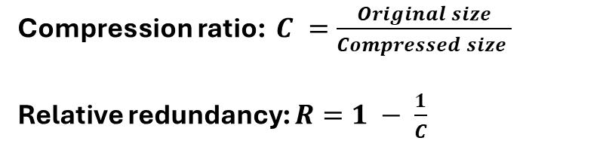
Compression Ratio and Redundancy(Math)
Formulas
Practice problem
A raw image is 2.4 MB and the compressed image is 0.3 MB.
1) Find the compression ratio.
2) Find the relative redundancy.
Solution outline:
C = 2.4/0.3 = 8
R = 1 - 1/8 = 0.875 = 87.5%
An image size is 65,536 bytes. After compression it becomes 6,554 bytes.
C = 65,536 / 6,554 ≈ 10
R = 1 - 1/10 = 0.9
So, we say the image has about 10:1 compression and 90% relative redundancy.

Slide 12
Lossless vs Lossy Compression

Slide 13
Lossless vs Lossy Compression
Lossless Compression
You get exact same data back after decompressing
No information is lost
It just removes extra/repeated data
Typical methods: Huffman, Run-Length, PNG, ZIP Used for: text files, code, medical data
Lossy Compression
You don’t get exact original back
Some less important data is removed
File size becomes much smaller
Typical methods: JPEG, MPEG, MP3 Used for: photos, videos, music
Note: Lossless means exact recovery. Lossy means acceptable recovery based on perception or application requirement.

Slide 14
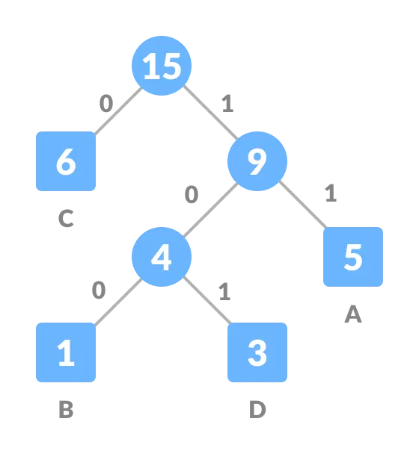
Huffman Coding

Slide 15
Huffman Coding
Definition
Huffman coding is a lossless variable-length coding technique. It assigns short codes to frequent symbols and longer codes to rare symbols.
Compare fixed vs variable length
Suppose four symbols use equal 2-bit fixed code. If one symbol appears much more often, variable-length coding can lower the average below 2 bits/symbol.
Why it works
If common symbols use fewer bits, the average number of bits per symbol decreases. That means lower storage while preserving exact information.

Slide 16
Huffman Coding
Step-by-step algorithm
1. Count the frequency of each symbol.
2. Put all symbols into a min-priority queue.
3. Remove the two nodes with smallest frequency.
4. Combine them into a new parent node whose frequency is the sum.
5. Insert the parent back into the queue.
6. Repeat until one root remains.
7. Assign 0 to each left edge and 1 to each right edge.
8. The root-to-leaf path gives the code for each symbol.
Time-saving exam tip
In the exam, always write frequencies in ascending order first. Then combine the two smallest repeatedly.
Important property
No Huffman code is a prefix of another Huffman code. Therefore, the bitstream can be decoded unambiguously.

Slide 17
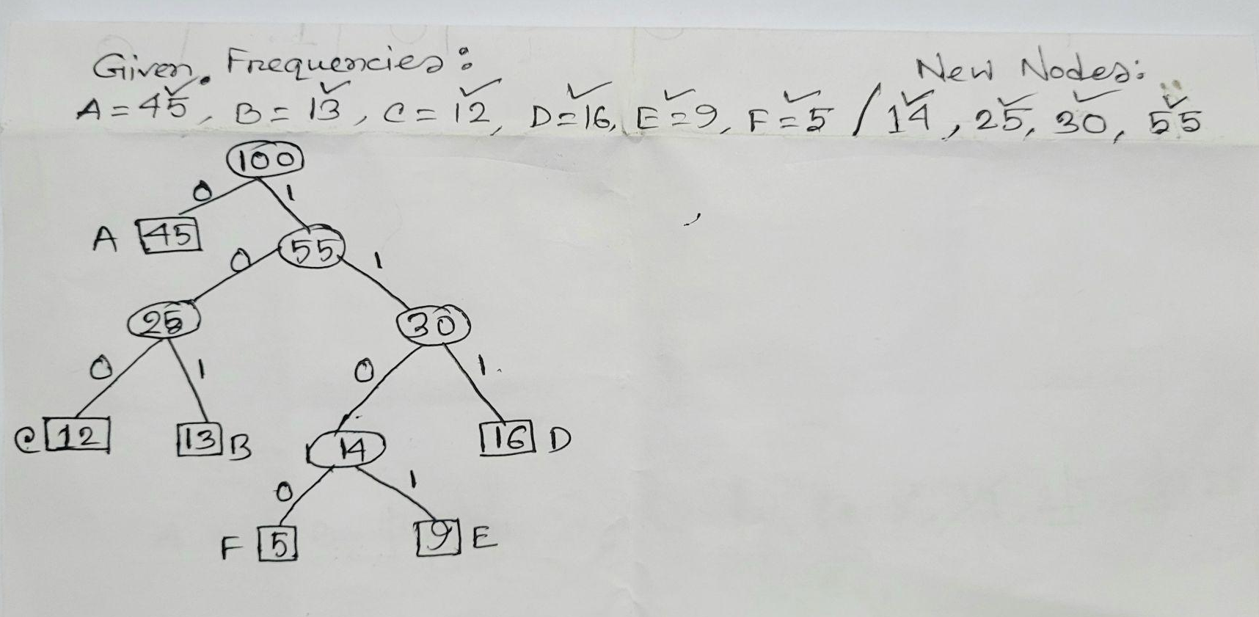
Worked Example: Build a Huffman Tree
Given frequencies: A=45, B=13, C=12, D=16, E=9, F=5

Slide 18
Worked Example: Build a Huffman Tree
Given frequencies: A=45, B=13, C=12, D=16, E=9, F=5
One valid code set
Step | Choose smallest two | New node | Remaining set
1 | F=5 and E=9 | 14 | 12,13,14,16,45
2 | C=12 and B=13 | 25 | 14,16,25,45
3 | 14 and D=16 | 30 | 25,30,45
4 | 25 and 30 | 55 | 45,55
5 | 45 and 55 | 100 root | done
A = 0
C = 100
B = 101
F = 1100
E = 1101
D = 111
Exact 0/1 assignments may swap left and right, but code lengths remain valid.

Slide 19
Huffman Coding: Average Bit Length and Compression
Calculation
Compare with fixed-length coding
Using the valid code lengths from the previous slide:
A: 1 bit, B: 3 bits, C: 3 bits, D: 3 bits, E: 4 bits, F: 4 bits
Average length Lavg
= (45×1 + 13×3 + 12×3 + 16×3 + 9×4 + 5×4) / 100
= (45 + 39 + 36 + 48 + 36 + 20) / 100
= 224 / 100
= 2.24 bits/symbol
There are 6 symbols. Fixed-length code needs 3 bits/symbol because 2^2 < 6 ≤ 2^3.
So, Huffman saves 3 - 2.24 = 0.76 bits/symbol on average.
Compression estimate
Approximate compression ratio
= fixed / Huffman = 3 / 2.24 ≈ 1.34 : 1

Slide 20
Huffman Coding
Problem
Answer outline
Symbols and frequencies:
P=30, Q=25, R=20, S=15, T=10
Tasks:
1. Draw the Huffman tree.
2. Write one valid code for each symbol.
3. Compute average bits/symbol.
4. Compare with fixed-length coding.
Possible combining order:
10+15=25
20+25=45
25+30=55
45+55=100
One valid code set:
R=00, Q=01, T=100, S=101, P=11
Lengths: 2,2,3,3,2
Lavg = (30×2 + 25×2 + 20×2 + 15×3 + 10×3)/100
= 225/100 = 2.25 bits/symbol
Fixed-length for 5 symbols = 3 bits/symbol

Slide 21
JPEG Compression

Slide 22
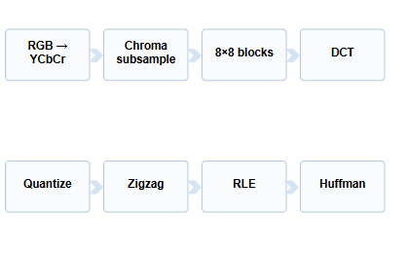
JPEG
What is JPEG?
JPEG is a lossy image compression method
Mainly used for photos (natural images), not for text or simple drawings.
It reduces file size by removing less important details
Uses how humans see images to decide what to remove
Why does it work so well?
It plays a trick on our eyes!
Human eyes are very good at seeing brightness (light and dark).
However, our eyes are not very good at seeing tiny details in color.
JPEG saves space by keeping the brightness perfect but throwing away color details we wouldn't notice anyway

Slide 23
JPEG
To save space on your phone or computer, here is the step-by-step breakdown of how it works-
1. Change the "Color Language" (RGB to YCbCr)
Computers usually think in Red, Green, and Blue. JPEG changes this into Brightness (Y) and Color (Cb and Cr).
Why? Our eyes are super sensitive to how bright something is, but we are actually quite bad at seeing tiny color details.
2. Color Reduction (Chroma Subsample)
Our eyes are not very good at noticing fine details in color.
So JPEG can reduce the resolution of Cb and Cr (color parts) without making the image look bad.
A common method is called 4:2:0 — it stores color at half the resolution both horizontally and vertically.
This saves space while keeping brightness sharp.
3. The 8x8 Blocking / Cutting
Instead of trying to handle the whole photo at once, JPEG chops the image into tiny squares of 8x8 pixels.
The Downside: If you compress a photo too much, you’ll start seeing the edges of these little squares (this is why low-quality photos look "blocky").

Slide 24
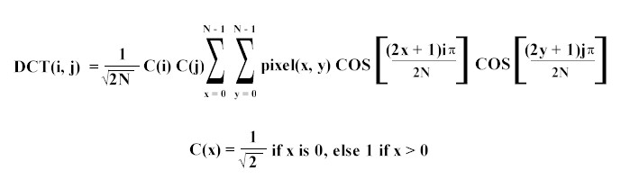
JPEG
4. Math Magic (DCT)
Now, JPEG uses a mathematical trick called Discrete Cosine Transform (DCT). It changes the pixels from "dots of color" into "waves of detail."
It separates the big, important shapes (Low Frequency) from the tiny, busy details (High Frequency).
5. Rounding Off (Quantization) — The Most Important Step
This is where the actual "shrinking" happens. JPEG takes all those "waves of detail" and rounds the numbers off.
Example: Instead of saving a specific number like 17.34, it just saves 17
Lossy: Because we are rounding off, we can never get the exact original numbers back. This is why JPEG is called "lossy" compression.

Slide 25
JPEG
6. Sorting (Zigzag)
JPEG sorts the numbers in a zigzag pattern. It puts the big, important numbers first and the small, unimportant zeros at the end.
7. Final Packing (RLE and Huffman)
Finally, it uses two more tricks to pack the data tightly:
RLE: Instead of saying "0, 0, 0, 0, 0," it just says "Five zeros."
Huffman: It gives short codes to things that happen often and long codes to things that are rare (like a digital version of Morse code).

Slide 26
JPEG
Problem
Solution
After DCT, assume a small coefficient sequence is:
[80, 18, 9, 3, 2, 1, 0, 0]
Quantization divisors are:
[8, 6, 9, 10, 12, 15, 20, 25]
Tasks:
1. Quantize each value.
2. Which values become zero?
3. Why does this help compression?
Quantized values:
80/8 = 10
18/6 = 3
9/9 = 1
3/10 ≈ 0
2/12 ≈ 0
1/15 ≈ 0
0/20 = 0
0/25 = 0
Result: [10, 3, 1, 0, 0, 0, 0, 0]
Now the tail has a long run of zeros.
Zigzag + RLE + Huffman can compress this very well.

Slide 27
JPEG
Problem 1
Problem 2
Problem 3
State the major steps of JPEG in correct order.
Expected order:
Color transform -> subsampling -> blocking -> DCT -> quantization -> zigzag -> RLE -> Huffman
Which step of JPEG is lossy?
Why?
Expected answer:
Quantization. Because rounded coefficient values cannot be perfectly recovered.
Why does JPEG work better for photographs than for text diagrams?
Expected idea:
Photos tolerate small smooth losses better; sharp edges in text/artifacts become more visible.

Slide 28
MPEG Compression

Slide 29
MPEG
MPEG (video) is an upgraded version of JPEG (photos) that is much smarter about saving space.
The Main Problem
A video is just a long string of photos (called frames) shown very fast.
If you used JPEG to compress a video, you would have to save every single photo separately.
This is a waste of space because, in a video, the next photo is usually almost exactly the same as the one before it.
MPEG Strategy
MPEG is the video version of JPEG (MPEG = Moving Picture Experts Group).
It uses two kinds of compression together:
Spatial compression (inside each frame) → like JPEG.
Temporal compression (across frames) → new for video.
By combining both, MPEG can compress video much more than compressing each frame as a separate JPEG.
Real-world example: Imagine a person talking in front of a fixed background:
The background (wall, door, etc.) stays the same from frame to frame.
Only the person's mouth, eyes, or hands move.

Slide 30
MPEG Frame Types: I, P and B
1. I-frames (The Full Picture)
Full Name: Intra-coded frame.
This is like a complete, normal photograph. It doesn't need any other frames to work; it has all the details by itself.
Size: These are the largest frames because they carry the most information.
Use: They are used as a "reference" or starting point for other frames.
2. P-frames (The "Look Back" Picture)
Full Name: Predicted frame.
This frame only saves what has changed since the last picture. It "looks back" at a previous I-frame or P-frame to figure out what moved.
Size: Medium size.
Use: It saves space by only storing motion and small leftovers instead of the whole image.
3. B-frames (The "Sandwich" Picture)
Full Name: Bi-directional frame.
This is the smartest and most efficient frame. It looks at both the picture before it and the picture after it to fill in the gaps.
Size: These are the smallest and save the most space.
GOP = Group of Pictures. It is the repeated pattern that organizes I, P and B frames.
Example GOP: I B B P B B P B B I

Slide 31
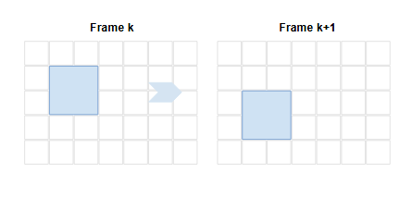
Motion Compensation: The Heart of MPEG
Concept: Instead of sending the whole next block, MPEG searches for a similar block in a reference frame. It sends the motion vector and the residual difference.
Simple math example
A block moves 2 pixels right and 1 pixel down.
Motion vector = ( +2, +1 )
Predicted block = block from old frame shifted by that vector.
Residual = actual new block - predicted block.
Math Problem:
A block moves from position (10,12) in one frame to (13,14) in the next.
Find the motion vector.
Answer: (+3, +2)

Slide 32
Thank You…

